Slide 1
Soft Computing Tools
in Engineering
Smart Semester Forecast
Spring 2018-19
Abhishek Patwari
Shivam Raj
Laxman Singh Rawat
Pankaj Aggarwal
Tanishq Garg
Term Project
Group 6
Smart Campus

Slide 2
Smart Campus?
Smart Buildings
Smart Transportation and security
Smart Administration
Smart Course system
Smart connectivity and tracking system
Smart Students ….. ?

Slide 3
Let me ask you?
What will be grade in Soft Computing? (Guess)
Will you be deregistered in Soft Computing?

Slide 4


Slide 5
Deregistration - For/ Against
Professor’s Perspective:
Poor performance of students in the class
Institute’s Rule & Regulations
Hence: should be deregistered. ☺

Slide 6
Real Scenario
Students’ perspective:
Involvement in many activities:
Internships applications
Projects
Research papers
Societies
Miss the Bus ??
Hall activities etc etc…..
Low interest stimulation
Early Morning Classes followed by overnight workloads
Low Attendance
Result- Deregistered. ☹

Slide 7


NEED
A scheme which can be compatible with the administration and fair enough with the students?
Excited?

Slide 8
Smart Deregistration System

Slide 9
Won’t it be great, If the student is deregistered only if most needed?

Slide 10
Factors to be considered before taking the critical step of deregistration:
CGPA
Marks
Attendance

Slide 11

Why fuzzy?

Slide 12
Since the definition of a “Good student” changes from professor to professor.
The range of adequate Attendance, Marks and CGPA is indeed much better defined in fuzzy terms such as ‘high’, ‘average’ and ‘low’.

Slide 13
Opportunity For Professor
He can adjust weights and membership functions of all the input parameters, according to his perspective. (He may give zero weights to marks and GPA)
Opportunity For Students
One can keep track of his current status
One can skip some classes if he can perform well

Slide 14
Input Parameters
Midsems Marks - low, average, high
Current GPA - low, average, high
Attendance percentage - low, average, high
All input values are normalised between (0,1)

Slide 15
Output Parameters
Deregistration Status:
Imminent - one should be deregistered
May be - alarmed condition
Not to be - safe zone

Slide 16
Rule Base
Rule no. | Attendance | Marks | CGPA | Dereg. Status
1. | Low | Low | Low | Imminent
2. | Average | Average | Average | May be
3. | High | High | High | Not to be

Slide 17
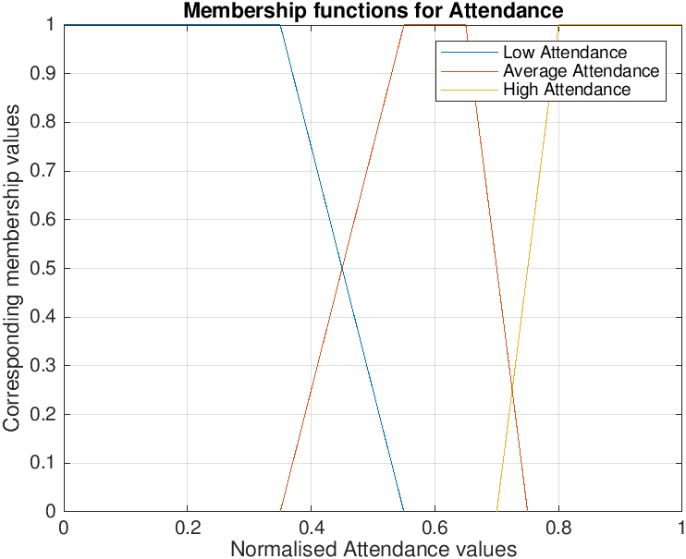
Default Membership functions
To start with optimised default values as set, as shown:

Slide 18
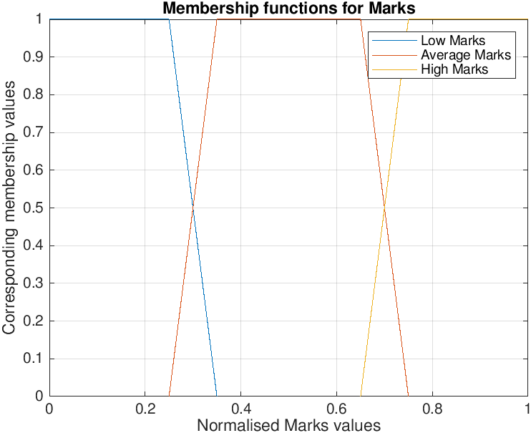
Default Membership functions

Slide 19
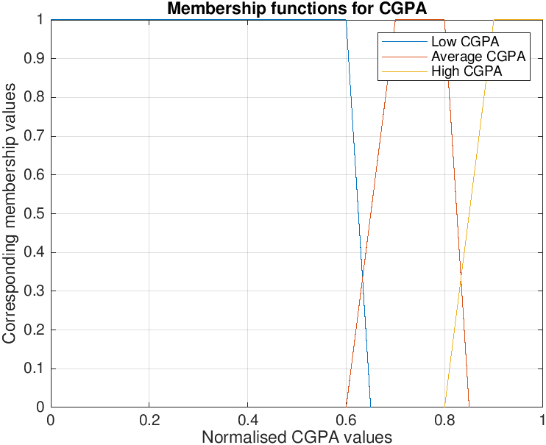
Default Membership functions

Slide 20
Default Weight
Attendance : 55%
Marks : 35%
Current CGPA : 10%

Slide 21
Model Development
Individual Testing
Used for
Fine tuning*
Optimisation
Individual Crosscheck
Direct print Dereg. status
*Professor can use to decide weights and membership functions limits
Combined Testing
Used for checking status of every student of the class
Input .csv file with input parameters in normalised form.
Output .csv file with contain deregistration status printed for whole class.

Slide 22
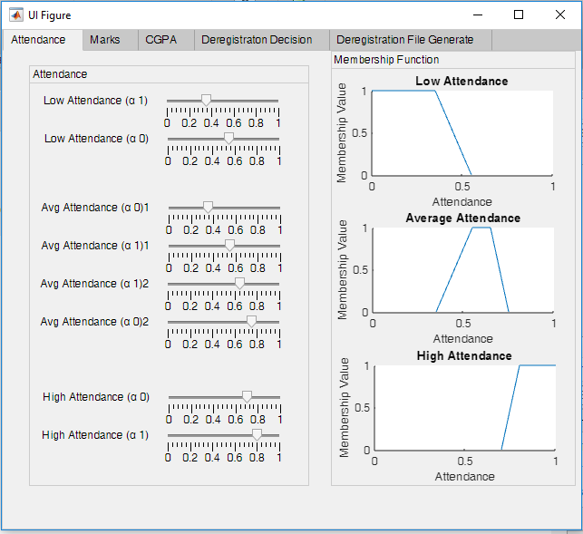
Attendance Function def.

Slide 23
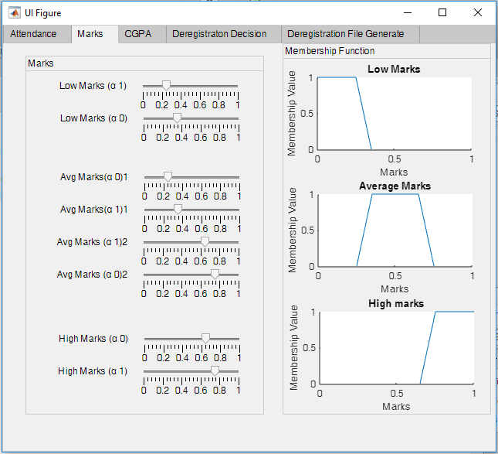
Marks Function def.

Slide 24
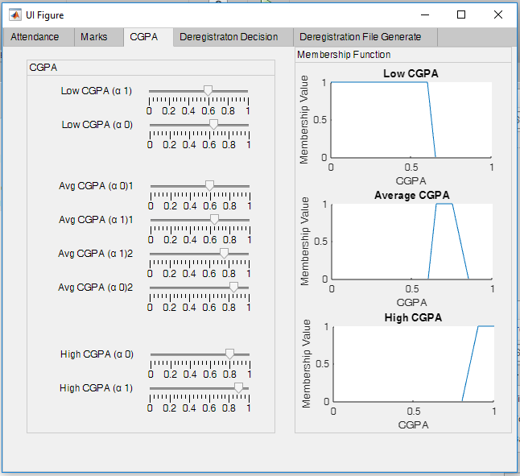
CGPA Function def.

Slide 25
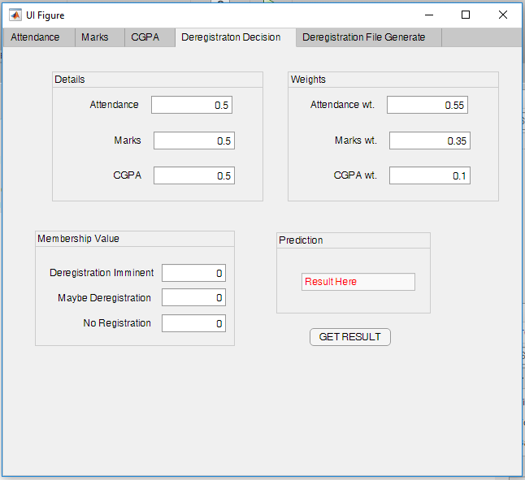
Deregistration Status

Slide 26
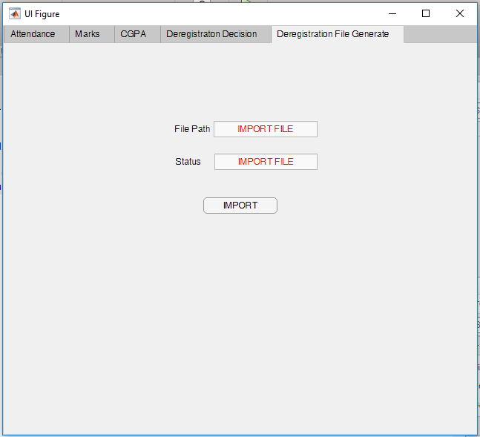

Slide 27
Smart Grade Prediction System

Slide 28
What is it ?
A neural network based model which can predict students’ grade in a particular subject using:
Previous Year’s grade distribution
Current Midsems & Class Test Marks
Attendance

Slide 29
Benefits for Students
One can predict his upcoming results.
He/She can calculate his GPA.
He/She can focus more to improve his/her grades.
Consult with professor for the scope of improvement.
Can have a better competition

Slide 30
How Model Works?
Input Parameters
Training of Model
Testing of Model

Slide 31
Parameters
Expected Grade of a student in subject depends upon:
Input Parameters
Previous year grade distribution
Class tests Marks of the student
Midsems Marks of the student
Attendance of the student
CGPA of the student
Output Grades
A,B,C & F

Slide 32
Data Collection
Data of 80 students in MA31007 (Mathematical Methods) in Autumn 2018 .
Relevant Features Selected -
Class test & Mid Sem marks
Attendance
CGPA
Final Grade

Slide 33
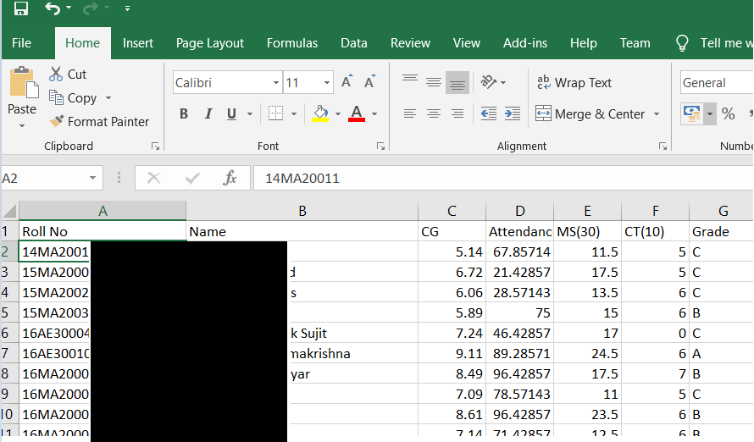
Data Sample

Slide 34
Preliminary Data Analysis
Missing fields filtered to yield a total of 71 students
Original grade distribution
Reduced grade spectrum by merging grades as per:-
Ex, A -> A B,C -> B D,P -> C F -> F

Slide 35
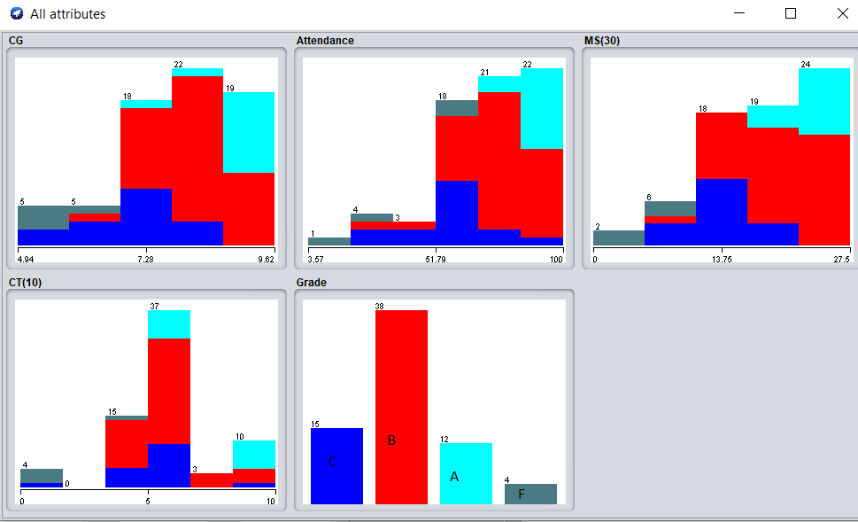

Slide 36
Nature of distribution- Skewed / Unbalanced
A-12 B-38 C-15 F- 6

Slide 37
Solution
Use of SMOTE (Synthetic Minority Over-sampling Technique)
Data points generated :
A-38, B-38, C-38, F-38

Slide 38
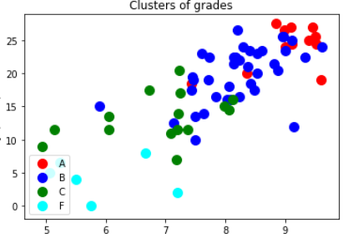
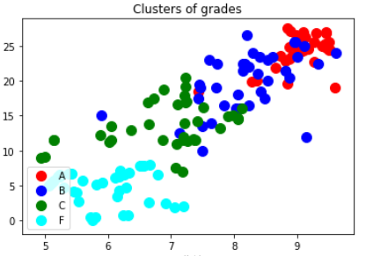
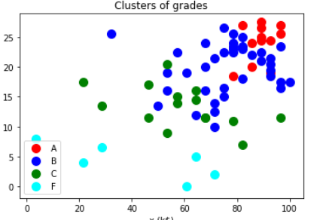
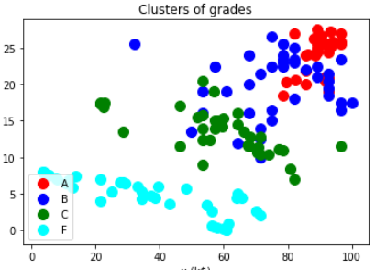
Before Smote After Smote
Marks
vs
CGPA
Marks
vs
Attendance

Slide 39
Model Selection Steps:-
Without Smote:
Architectures tried:- 4*(n1)*(n2)*4
4 * (n)* 4 - Better Results
Best accuracy obtained-> Training set- 76%
Test Set- 70%
For n(hidden)=11

Slide 40
Model Selection Continued
With Smote:
Architectures tried:- 4*(n1)*(n2)*4
4 * (n1)* 4 - Better Results
Best accuracy obtained-> Training set- 83%
Test Set- 84%
for n(hidden)=8
PCA did not yield any better results

Slide 41
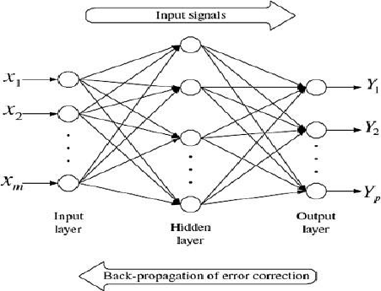
Final Model Architecture
One hidden layer with 8 neurons
4 inputs
4 outputs
Activations-{ Relu , Softmax }

Slide 42
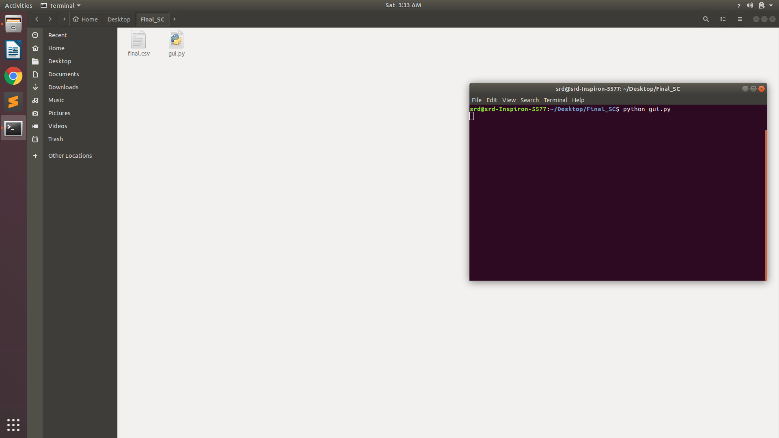

Slide 43
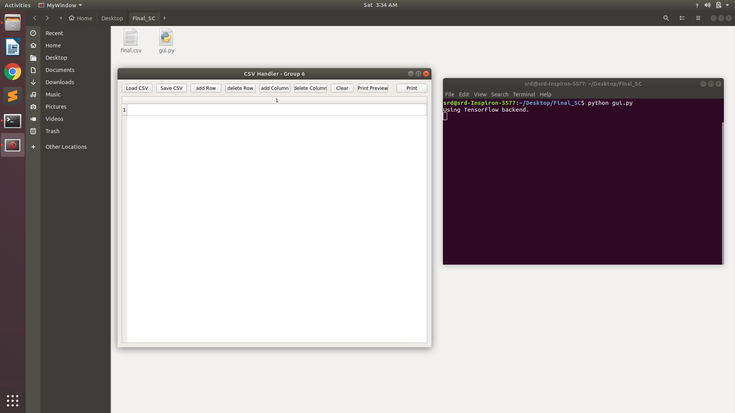

Slide 44
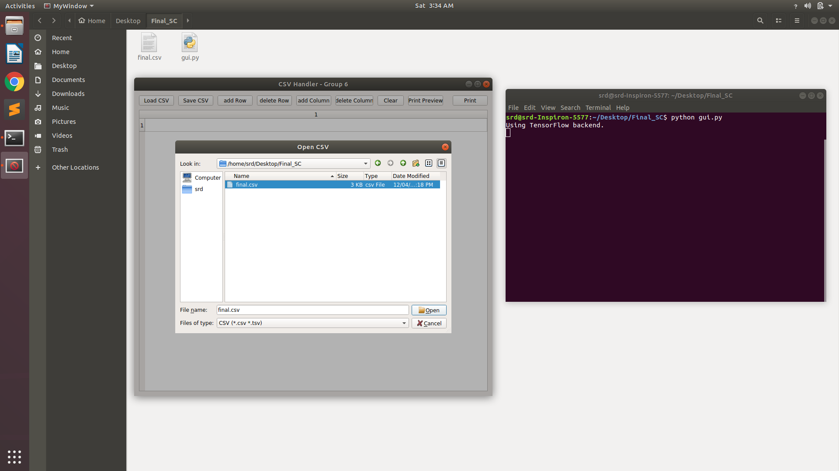

Slide 45
Limitations
The model requires training and some effort from the Professor’s side for grade prediction.
It does not consider deregistration due to disciplinary actions.

Slide 46
Future Prospects
Web based or application based model can be developed combining both models.
Weights can be fuzzified for smart deregistration model.
Various add ups can be made w.r.t student track:
Health status
Activities track
Interest finder for students
Model to analyse grades, which can improve the status of weaker section.
Model which give optimised course work for an student according to his capabilities.

Slide 47
References/ Tools Used:-
Weka - Machine Learning Library
Matlab 2018

Slide 48
Clarifications?

